Slide 1

Graduate Admissions Analysis
Group Members:
Aashrith Sangani (asangani1@student.gsu.edu)
Ayan Basu (abasu7@student.gsu.edu)
Kumar Shivam (kshivam1@student.gsu.edu)
Satyaraj Reddy Nandi (snandi1@student.gsu.edu)

Slide 2
Contents
Project Description
Dataset
Data Exploration and Preprocessing
Model
Linear Regression
Random Forest
KNN
Neural Network Model
Ensemble: Logistic and KNN with Averaging

Slide 3
Contents
Results and discussion
Summary
References

Slide 4
Project Description
Use the dataset to predict the chances of Indian students getting an admit by an US university for Graduate program.
The prediction is based on several academic performance indices of the student.
The project discusses steps such as data exploration, data preprocessing, correlation, etc. to train Machine Learning models, make prediction and assess their performance.

Slide 5
Dataset
The dataset being used in the project has been sourced from A Comparison of Regression Models for Prediction of Graduate Admissions, IEEE International Conference on Computational Intelligence in Data Science 2019.
Link to the dataset: https://www.kaggle.com/mohansacharya/graduate-admissions.
The dataset contains various academic parameters based on which the student’s profile is evaluated.

Slide 6
Data Exploration and Preprocessing
The input variables are:
GRE Scores ( out of 340 )
TOEFL Scores ( out of 120 )
University Rating ( out of 5 )
Strength of Statement of Purpose ( out of 5 )
Strength of Letter of Recommendation ( out of 5 )
Undergraduate CGPA ( out of 10 )
Research Experience ( either 0 or 1 )
The output variable is:
Chance of Admit

Slide 7
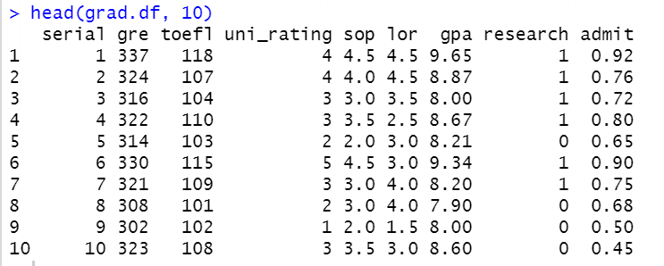
Data Exploration and Preprocessing
Top 10 records of the dataset

Slide 8
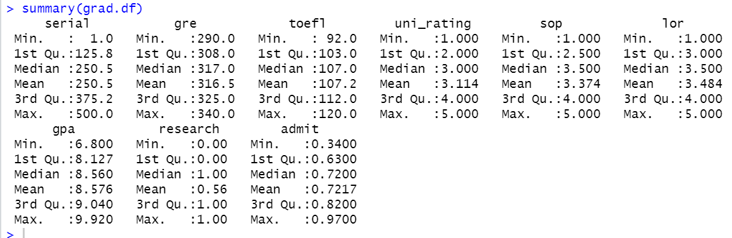
Data Exploration and Preprocessing
Summary of the dataset

Slide 9


Data Exploration and Preprocessing
The dataset did not have any missing or empty data.
Code snippet:

Slide 10
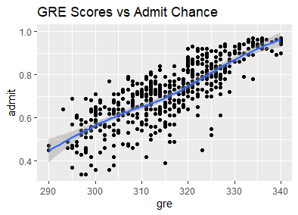
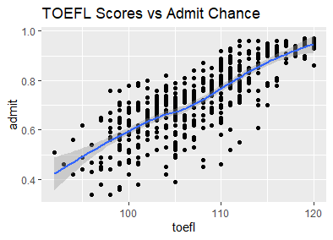
Data Exploration and Preprocessing
Visualizations

Slide 11
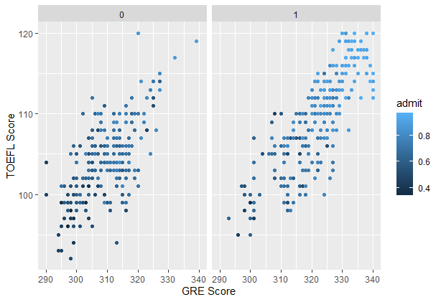
Data Exploration and Preprocessing
Visualizations

Slide 12
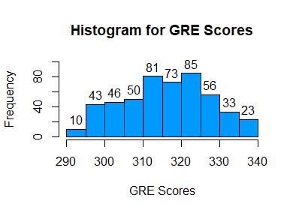
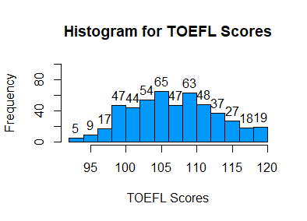
Data Exploration and Preprocessing
Visualizations

Slide 13
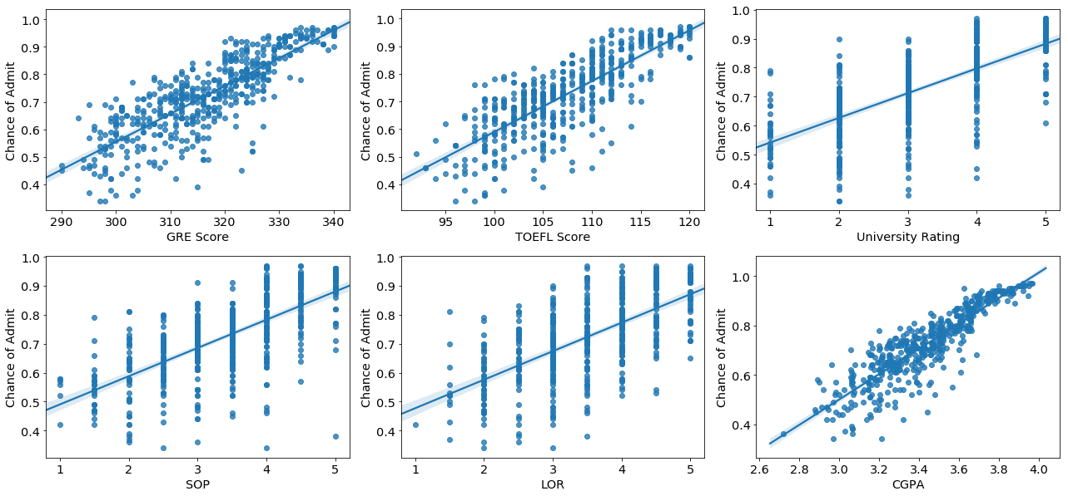
Data Exploration and Preprocessing

Slide 14
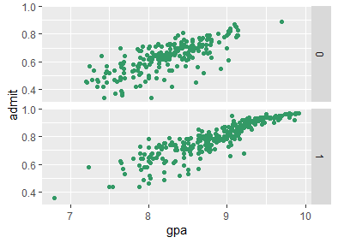
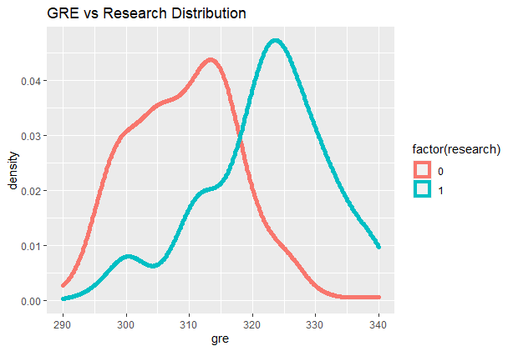
Data Exploration and Preprocessing
Visualizations

Slide 15
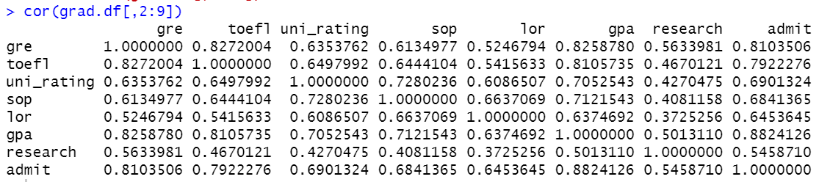
Data Exploration and Preprocessing
Correlation
Strong correlation between GPA & GRE and with TOEFL score
GRE and TOEFL scores also appears to be strongly correlated
GPA is the major factor for an admit in a grad school followed by GRE and TOEFL scores.

Slide 16
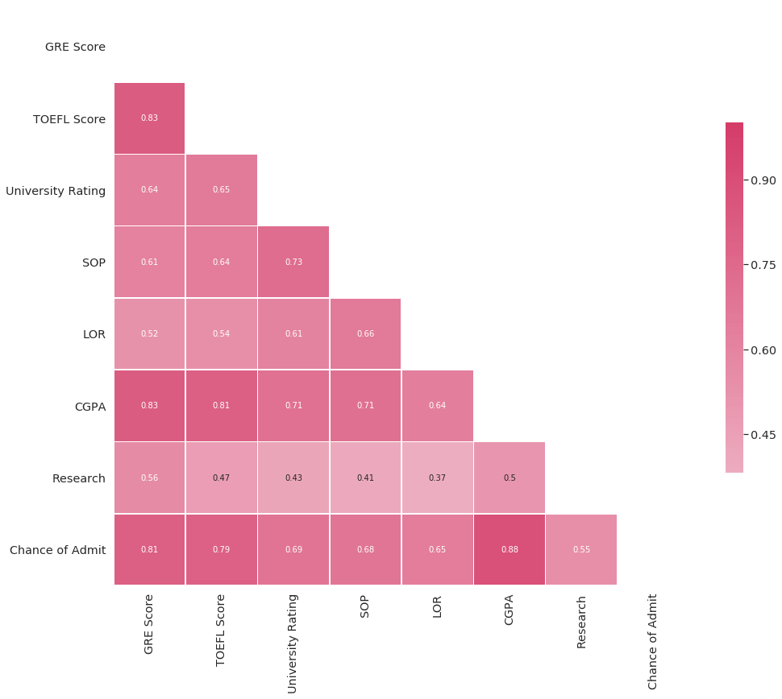
Data Exploration and Preprocessing

Slide 17
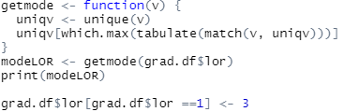
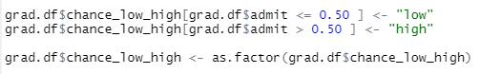
Data Exploration and Preprocessing
Data Transformation
There is one outlier in LOR and chance of admit. The lor outlier is 1 and the chance of admit is 0.34. We replaced that particular LOR’s value with mode to impute the outlier.
Converted research into a categorical variable.
Created a new categorical variable out of the feature: admit.
Data Partition:
Random sampling
Training dataset: 80%
Validation dataset: 20%

Slide 18
Model
The below models were developed:
Linear Regression
Random Forest
KNN
Neural Network
Ensemble: Logistic and KNN with Averaging

Slide 19
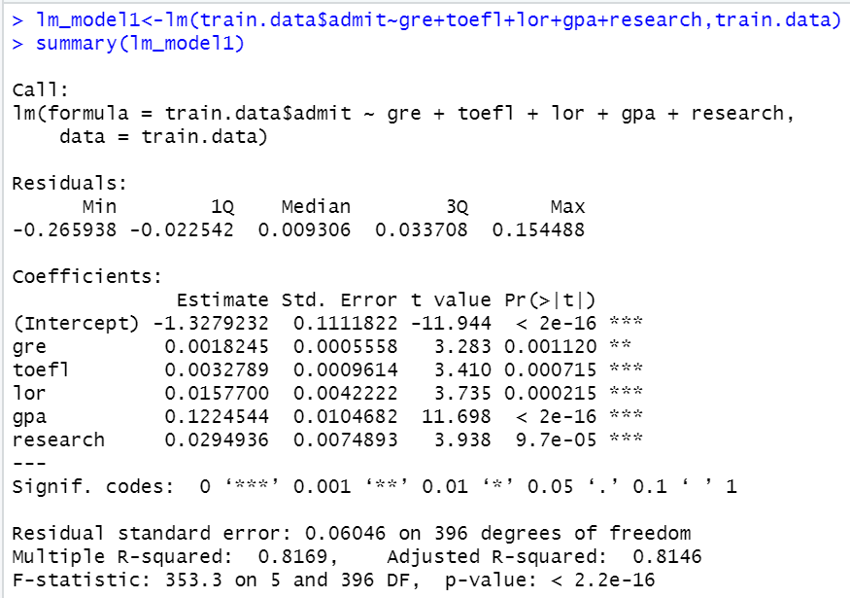
Linear Regression

Slide 20
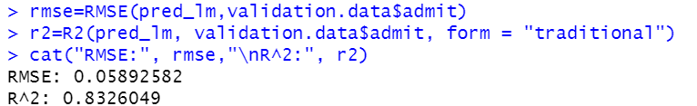
Linear Regression
RMSE: 0.0589
R²: 0.8326

Slide 21
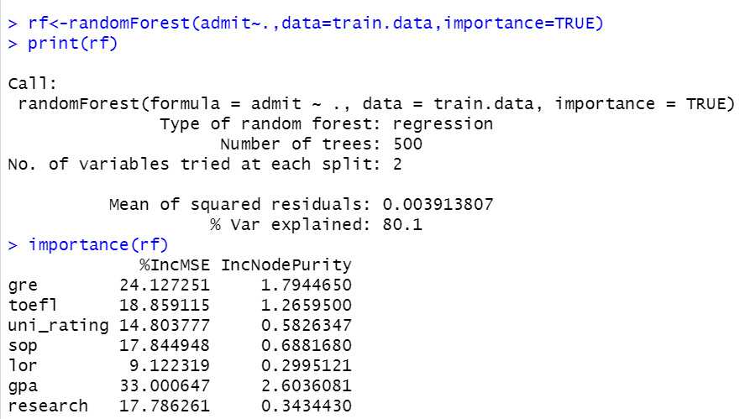
Random Forest

Slide 22
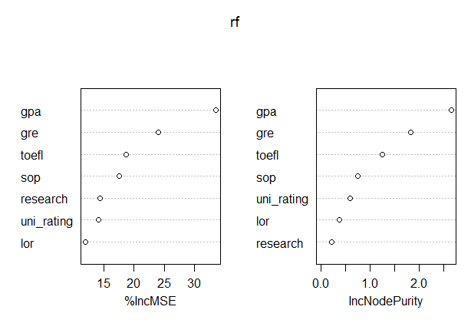
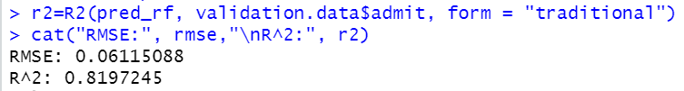
Random Forest
RMSE: 0.0611
R²: 0.8197

Slide 23
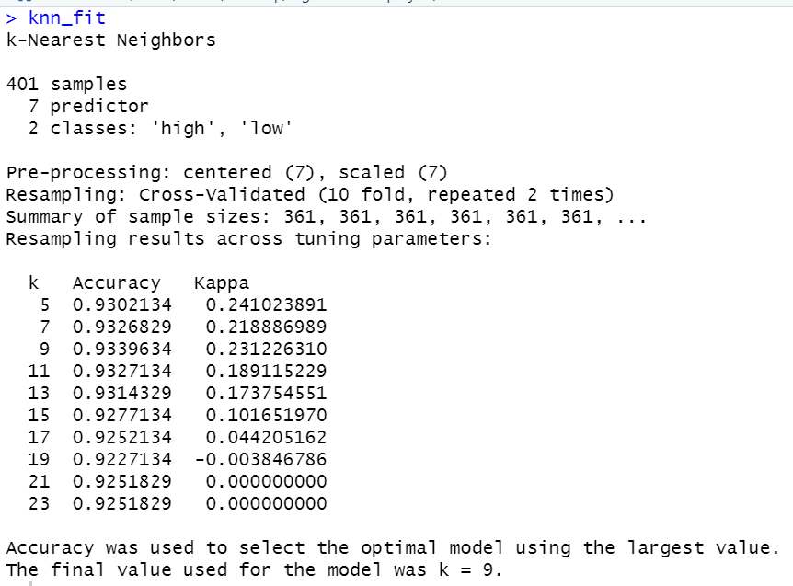
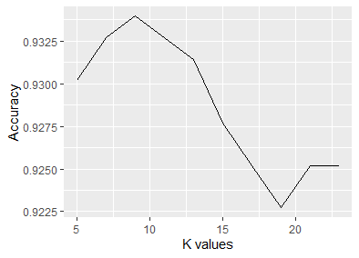
KNN

Slide 24
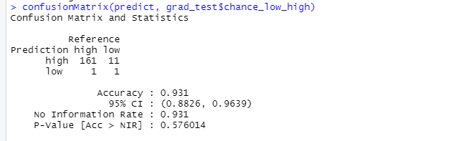
KNN
Accuracy: 93.1%

Slide 25
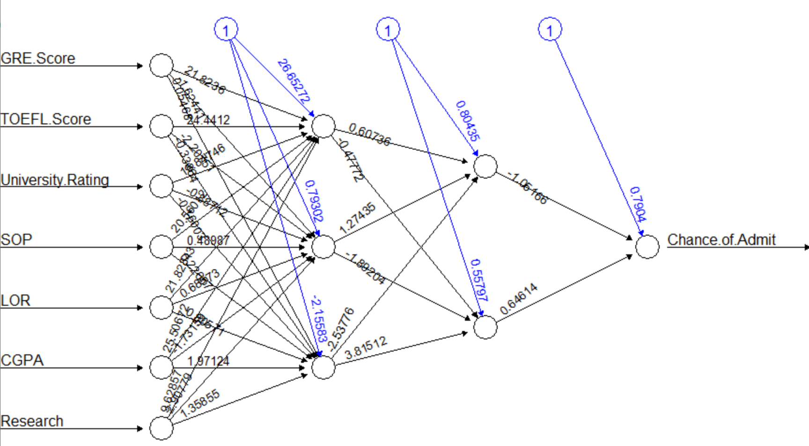
Neural Network

Slide 26
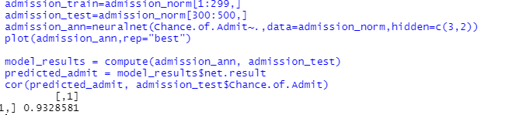
Neural Network
Accuracy: 93.28%

Slide 27
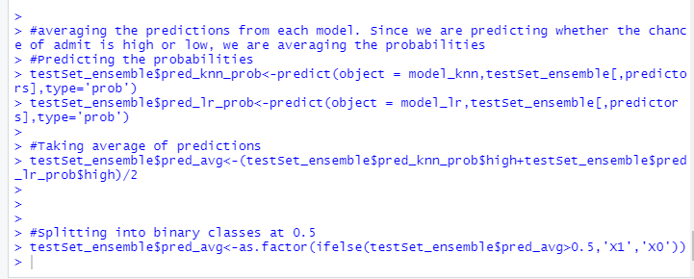
Ensemble: Logistic and KNN with Averaging

Slide 28
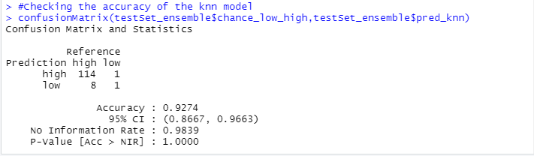
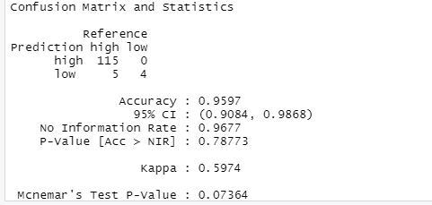
Accuracy of the KNN model using ensembling
Accuracy of the logistic regression model using ensembling

Slide 29
Results and discussion
With the influx of millions of students aspiring for graduate education is an all time high, there’s bound to be vast data which is to be analyzed.
These type of cutting-edge ML algorithms can be employed by the consulting agencies in helping countless students to predict their chances in getting admits at a graduate school.
Rich insights like these can better prepare the undergrad students in lieu of prioritizing their applications journey so that they can concentrate better on certain aspects.

Slide 30
References
Mohan S Acharya, Asfia Armaan, Aneeta S Antony : A Comparison of Regression Models for Prediction of Graduate Admissions, IEEE International Conference on Computational Intelligence in Data Science 2019.

Slide 31
Questions?

